Slide 1
COMPILER CONSTRUCTION

Slide 2
COURSE OUTCOMES
1 Compare different language Processors and design Lexical Analyzer for a given language.
2 Design Parser using top down and bottom up parsing techniques
3 Generate Intermediate code for a given set of instructions
4 Choose a data structures for symbol table organization and dynamic memory management
5 Apply various code optimization techniques to generate efficient target code

Slide 3
UNIT-I
Introduction: Language Processors, The structure of the compiler,
The science of building compiler.
Lexical analysis: The role of Lexical Analyzer, Input Buffering,
Specification of Tokens. Recognition of Tokens, The Lexical-Analyzer
Generator LEX.
UNIT-II
Syntax Analysis: Introduction, Context free grammars, Writing a
grammar, Top-Down parsing- Bottom-Up parsing, More powerful LR
parsers, Using ambiguous grammars, Parser Generators .UNIT-III
Syntax Directed Translation: Syntax Directed Definitions,
Evaluation Orders for SDDs, Applications of Syntax Directed
Translation.
Intermediate code generation: Introduction, Variants of syntax
trees, Three-Address Code, Types and Declarations, Translation of
Expressions, Type Checking. Control Flow.
UNIT-IV
Run-time Environments: Storage Organization, Stack Allocation of Space, Access to Non local Data on the Stack. Heap Management, Introduction to Garbage Collection
Symbol Table Organization: Structure of Symbol table, Symbol
Table organization for Block Structured and non block Structure
languages, Data Structures of symbol Table.
UNIT-V
Code Generation: Issues in the Design of a Code Generator, The
Target Language, Addresses in the Target Code Basic Blocks and Flow Graphs.
Code Optimization: Optimization of Basic Blocks. Peephole
Optimization, Register Allocation and Assignment, Machine
Independent Optimizations – The Principal Sources of Optimizations, Introduction to data flow analysis.

Slide 4
TEXT BOOK
Alfred V Aho, Monica S Lam, Ravi Sethi, Jeffrey D Ullman,Compilers: Principles, Techniques & Tools, 2nd Edition(2022), Pearson Education.

Slide 5
UNIT-I
Introduction:
Language Processors,
The structure of the compiler,
The science of building compiler,
Applications of compiler technology,
Programming language basics
Lexical analysis:
The role of Lexical Analyzer,
Input Buffering,
Specification of Tokens.
Recognition of Tokens,
The Lexical-Analyzer
Generator LEX.

Slide 6
What is compiler
A compiler is a translator that translates the high-level language into the machine language.
High-level language is written by a developer and machine language can be understood by the processor.
Compiler is used to show errors to the programmer.
The main purpose of compiler is to change the code written in one language without changing the meaning of the program.
When you execute a program which is written in HLL programming language then it executes into two parts.

Slide 7
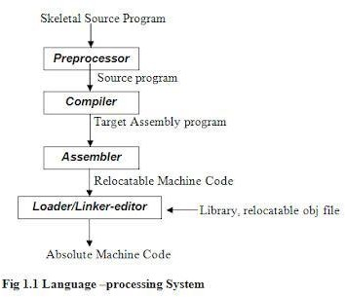

Slide 8
Preprocessor
A preprocessor produce input to compilers.
Compiler
A compiler is a program takes a program written in a source language and translates it into an equivalent program in a target language.
source program COMPILER target program
error messages
( Normally the equivalent program in
machine code – relocatable object file)
( Normally a program written in
a high-level programming language)

Slide 9
Compiler
A compiler is a translator used to convert high-level programming language to low-level programming language.
It converts the whole program in one session and reports errors detected after the conversion.
Interpreter
Just like a compiler, is a translator used to convert high-level programming language to low-level programming language.
It converts the program one at a time and reports errors detected at once, while doing the conversion. With this, it is easier to detect errors than in a compiler.

Slide 10
Common interpreters include Perl, Python, and Ruby interpreters, which execute Perl, Python, and Ruby code respectively.
Others include Unix shell interpreter, which runs operating system commands interactively.
Source program is interpreted every time it is executed (less efficient).
Interpreted languages are portable since they are not machine dependent. They can run on different operating systems and platforms.
They are translated on the spot and thus optimized for the system on which they’re being run.

Slide 11
Assembler
An assembler is a translator used to translate assembly language to machine language.
Assembly language is difficult to understand and Write, as it is a low-level programming language.
Loader and Link-editor
A loader is a program that places programs into memory and prepares them for
execution.

Slide 12
Science of Building a Compilers
Code Generation and Optimization
Modeling in Compiler Design and Implementation
Parsing (Recognition) Algorithms:
Syntax Directed Translation:
Generator grammars and semantic actions
Optimizing Code
Role of testing

Slide 13
Code Generation and Optimization
Code generation is the process of transforming a program written in a high-level language into machine code. It’s also known as compiling, and it’s basically what compilers do.
Code optimization is the process of improving the efficiency of an already generated computer program, by analyzing it and identifying possible enhancements that may speed up its execution time and/or reduce its storage requirements.
The process of optimization is sometimes referred to as program optimization or software optimization.

Slide 14
Modeling in Compiler Design and Implementation
In compiler design, modeling is a useful tool for representing the behavior of a compiler. Modeling can be used to model the language, its syntax and semantics, how it transforms source code into machine code (or vice versa).
One of the advantages of modeling is that it can help you identify potential problems in your design earlier, thereby saving time and money. You may also find that by using a formalism like BNF(Backus-Naur form), which has a well-defined syntax and semantics, you can communicate your ideas more clearly than if you were just using plain English.
Modeling can be done in any number of tools: from pencil and paper (or whiteboard) to electronic spreadsheets and advanced computer languages like Java or C.

Slide 15
Parsing (Recognition) Algorithms
Parsing is the process of converting a program into a parse tree, which can then be used to determine the program’s syntactic structure.
A top-down parser starts from the highest level structures in your source code and works its way down toward lower levels until it finds something that matches its rule set for parsing. Top-down parsers are typically used when you want 100% accuracy because they require much more effort than other methods but do not sacrifice speed since no backtracking occurs during execution time.
Bottom-up parsers are typically used when you want to be quick and easy but sacrifice accuracy since they do not require much effort to implement nor do they require much memory space to operate within.

Slide 16
Syntax Directed Translation
A syntax-directed translator (SDS) transforms source code from one format to another by converting each line into tokens which represent the next step of execution or state transition required by that line. The resulting executable code is called an intermediate representation (IR).
The advantage of a syntax-directed translation is its simplicity. It only requires one pass through the source code to create an executable program. The disadvantage is that a syntax-directed translator does not perform any semantic analysis on the source code, so it can produce incorrect results if there are errors in the syntax of the original program.

Slide 17
Optimizing Code
Optimizing code is the process of modifying a program’s source code in order to make it more efficient.
Optimization can improve a program’s speed, memory usage, or other attributes. The optimization process often involves transforming the source code into a form that has fewer instructions and/or fewer data storage space than the original form.
Optimizations may be performed by an automated compiler or interpreter (which transforms programs while they run), or manually by the programmer who wrote them; this distinction is important because different types of optimizations may be better suited for one type of system than another.

Slide 18
Generator grammars and semantic actions
Grammar is a set of rules that describes what can be said in a language. These rules allow us to analyze our source programs into well-formed pieces, which we then use for semantic analysis or code generation purposes.
Syntactic analysis was performed on the abstract syntax tree produced by parsing each source file into its corresponding intermediate representation (IR). Semantic actions then took this IR and modified it in some way before producing another IR based on an application-specific model of your target language’s semantics

Slide 19
Role of testing
Testing is important in compiler construction and testing helps to find bugs and improve the quality of the compiler.
Tools from software engineering: version control systems (Git), continuous integration servers (Jenkins), and automatic theorem proving tools like HOL Light from Microsoft Research Center Cambridge in order to achieve high-quality standards for our final product: compilers for programming languages such as Java or C#/.NET Framework.

Slide 20
Applications of Compiler Technology
Implementation of High-level Programming
2. Optimization of computer architectures
3. Design of new computer architectures
4. Program Translations
5. Software productivity tools
6. Artificial Intelligence
7.Gaming
8.Security
9. Embedded Systems
10. High-Performance Computing

Slide 21
Implementation of High-level Programming
A high-level programming language defines a programming abstraction: the programmer specifies an algorithm in the language, and the compiler must translate it to the target language.
Higher-level programming languages are sometimes easier to develop in, but they are inefficient, therefore the target applications run slower. Low-level language programmers have more control over their computations and, in principle, can design more efficient code.
Lower-level programs, on the other hand, are more difficult to build and much more difficult to maintain. They are less portable, more prone to errors, and more complex to manage. Optimized compilers employ ways to improve the performance of generated code, compensating for the inefficiency of high-level abstractions.

Slide 22
Optimization of computer architectures
Aside from the rapid evolution of computer architectures, there is a never-ending demand for new compiler technology. Almost all high-performance computers leverage parallelism and memory hierarchies as essential methods.
Parallelism may be found at two levels: at the instruction level, where many operations are performed at the same time, and at the processor level, where distinct threads of the same program are executed on different processors.
Memory hierarchies address the fundamental problem of being able to produce either extremely fast storage or extremely huge storage, but not both.

Slide 23
Design of new computer architectures
In the early days of computer architecture design, compilers were created after the machines were built. That isn’t the case now. Because high-level programming is the norm, the performance of a computer system is determined not just by its sheer speed, but also by how well compilers can use its capabilities.
Compilers are created at the processor-design stage of contemporary computer architecture development, and the resultant code is used to evaluate the proposed architectural features using simulators.

Slide 24
Program Translations
The compilation is typically thought of as a translation from a high-level language to the machine level, but the same approach may be used to translate across several languages. The following are some of the most common applications of software translation technologies.
Compiled Simulation
Binary translation
Hardware Syntheses
Database Query Interpreters

Slide 25
Software productivity tools
Programs are possibly the most complex technical objects ever created; they are made up of a plethora of little elements, each of which must be accurate before the program can function properly.
As a result, software mistakes are common; errors can cause a system to crash, generate incorrect results, expose a system to security threats, or even cause catastrophic failures in key systems. Testing is the most common method for discovering program flaws.
A fascinating and interesting complementary option is the use of data-flow analysis to statically discover problems

Slide 26
Artificial Intelligence:
Compilers are used in the field of artificial intelligence (AI) to optimize and generate code for deep learning models, computer vision, natural language processing, and other AI applications. AI compilers can optimize code for specific hardware architectures and can generate highly efficient code for AI workloads.
Gaming:
Game development often involves the use of compilers to generate code that runs on game consoles and PCs. Gaming compilers are optimized for performance, allowing game developers to create immersive, high-performance games.

Slide 27
Security:
Compilers are used in security applications to create code that is resistant to various forms of attacks, including buffer overflows, code injections, and other security vulnerabilities. Security compilers can generate code that is highly resistant to reverse engineering and tampering.
Embedded Systems:
Embedded systems are computer systems that are designed to perform specific functions in various devices such as automobiles, medical equipment, and consumer electronics. Compilers are used to generate machine code that runs on these devices, ensuring efficient use of resources and optimal performance.
High-Performance Computing:
Compilers are essential in the field of high-performance computing (HPC), which involves using supercomputers or clusters of computers to perform complex computations. HPC compilers are optimized for parallel processing and can generate highly efficient code for scientific simulations, data analysis, and other computationally intensive applications.

Slide 28
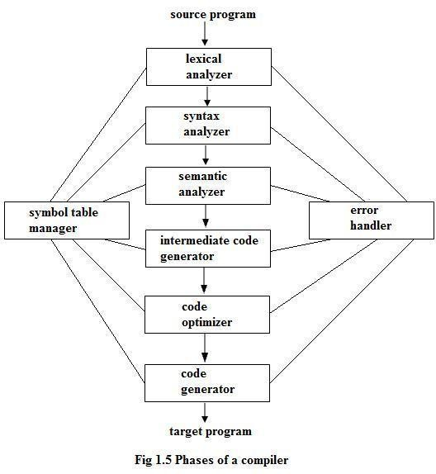

Slide 29
Phases of compiler
The compilation process contains the sequence of various phases. Each
phase takes source program in one representation and produces output
in another representation. Each phase takes input from its previous
stage.
Lexical Analysis
Lexical Analysis or Scanners reads the source program one character at
a time, carving the source program into a sequence of automatic units
called tokens.

Slide 30
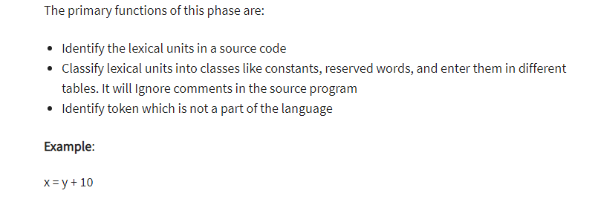
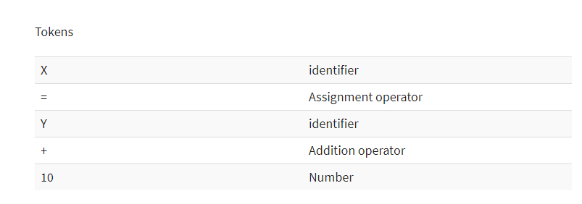

Slide 31
Syntax Analysis
The second stage of translation is called syntax analysis or parsing. In this phase expressions, statements, declarations etc… are identified by using the results of lexical analysis. Syntax analysis is aided by using techniques based on formal grammar of the programming language.
Semantic Analysis
Semantic analysis checks whether the parse tree constructed follows the rules of language The semantic analyzer produces an annotated syntax tree as an output.

Slide 32
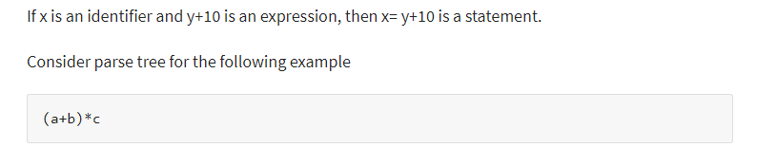
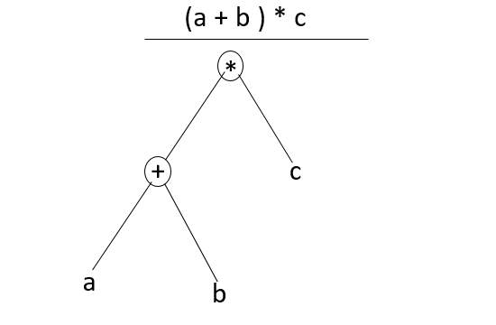

Slide 33
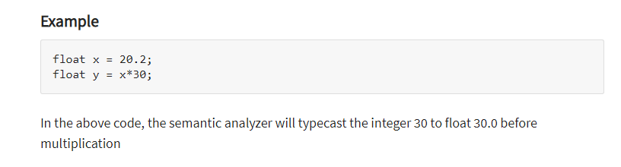
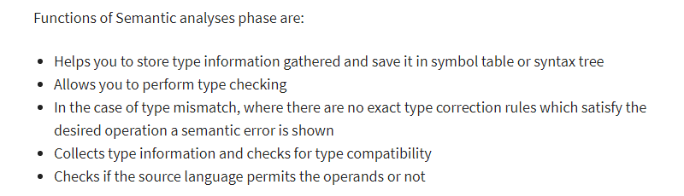

Slide 34
Intermediate Code Generations
An intermediate representation of the final machine language code is produced. This phase bridges the analysis and synthesis phases of translation.
Code Optimization
This is optional phase described to improve the intermediate code so that the output runs faster and takes less space.
Code Generation
A number of optimizations to Reduce the length of machine language
program are carried out during this phase. The output of the code generator is
the machine language program of the specified computer.

Slide 35
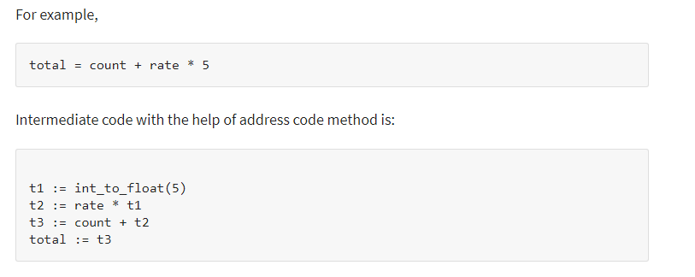
Intermediate code Generation Example

Slide 36
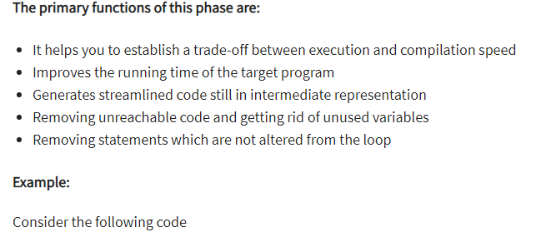
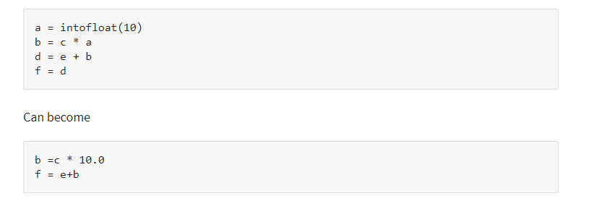
Code Optimization Example

Slide 37
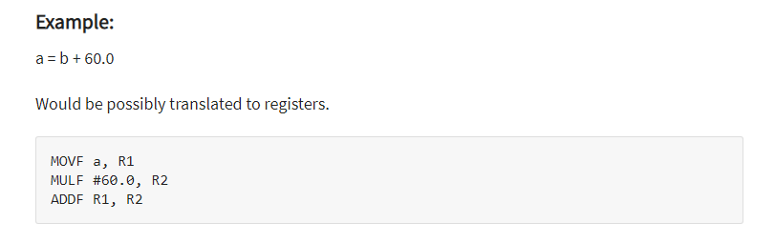
Code Generation Example

Slide 38
The Analysis-Synthesis Model of Compilation
There are two parts to compilation:
Analysis Phase
This is also known as the front-end of the compiler. It reads the source program, divides it into core parts and then checks for lexical, grammar and syntax errors. The analysis phase generates an intermediate representation of the source program and symbol table, which should be fed to the Synthesis phase as input.
Synthesis Phase
Its also known as the back-end of the compiler. It generates the target program with the help of intermediate source code representation and symbol table.

Slide 39
Other Tools that Use the Analysis-Synthesis Model
Editors (syntax highlighting)
Pretty printers (e.g. Doxygen)
Static checkers (e.g. Lint and Splint)
Interpreters
Text formatters (e.g. TeX and LaTeX)
Silicon compilers (e.g. VHDL)
Query interpreters/compilers (Databases)

Slide 40
Preprocessors, Assemblers and Linkers
A preprocessor considered as part of compiler, is a tool that produces input for compilers. It deals with macro-processing, file inclusion, language extension, etc.
Assembler
An assembler translates assembly language programs into machine code. The output of an assembler is called an object file, which contains a combination of machine instructions as well as the data required to place these instructions in memory.
Linker
A computer program that links and merges various object files together in order to make an executable file.
All these files might have been compiled by separate assemblers. The major task of a linker is to search and locate referenced module/routines in a program and to determine the memory location where these codes will be loaded, making the program instruction to have absolute references.

Slide 41
Phases of a Compiler
The compilation process is a sequence of various phases.
Each phase takes input from its previous stage and has its own representation of source program, and feeds its output to the next phase of the compiler.

Slide 42
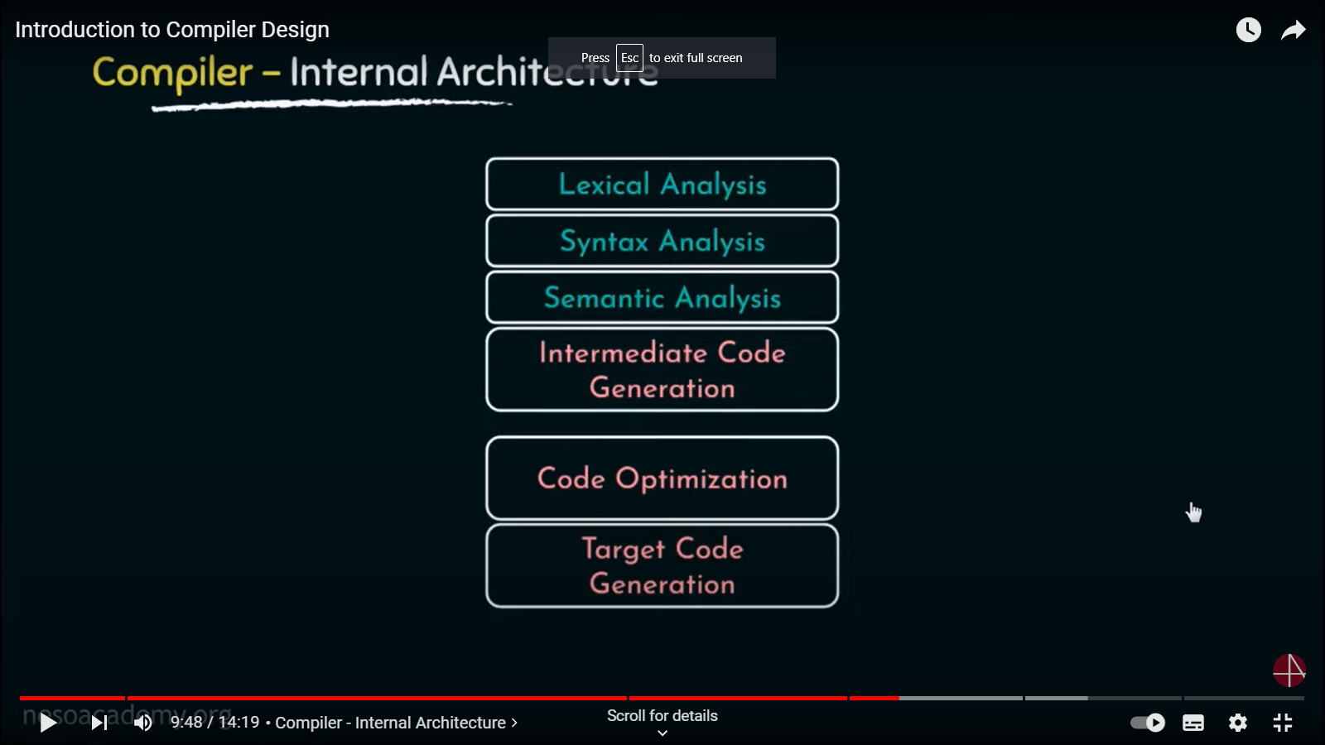

Slide 43
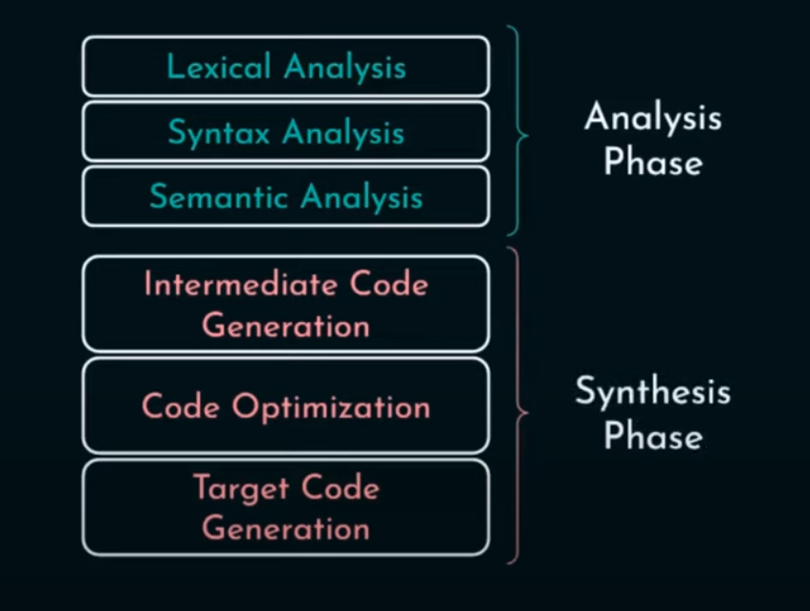

Slide 44
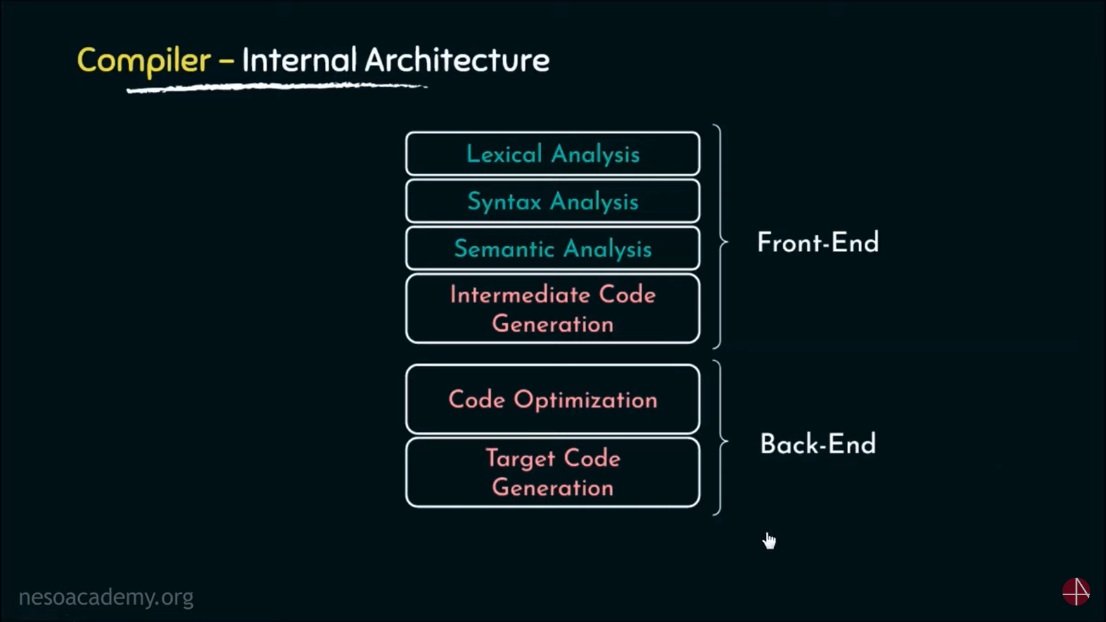

Slide 45
Front-end, Back-end division
Intermediate
Language
Source
code
Front end
IR
Back end
Machine
code
errors
Front end maps legal code into IR
Back end maps IR onto target machine
Allows multiple front ends
Multiple passes -> better code

Slide 46
Front end
Source
code
Scanner
tokens
Parser
IR
errors
Recognize legal code
Report errors
Produce IR
Preliminary storage maps

Slide 47
Front end
Source
code
Scanner
tokens
Parser
IR
errors
Scanner:
Maps characters into tokens – the basic unit of syntax
x = x + y becomes <id, x> = <id, x> + <id, y>
Typical tokens: number, id, +, -, *, /, do, end
Eliminate white space (tabs, blanks, comments)
A key issue is speed so instead of using a tool like LEX it sometimes needed to write your own scanner

Slide 48
Front end
Source
code
Scanner
tokens
Parser
IR
errors
Parser:
Recognize context-free syntax
Guide context-sensitive analysis
Construct IR
Produce meaningful error messages
Attempt error correction
There are parser generators like YACC which automates much of the work

Slide 49
Middle end (optimizer)
Modern optimizers are usually built as a set of passes
Typical passes
Constant propagation
Common sub-expression elimination
Redundant store elimination
Dead code elimination

Slide 50
Phases of a Compiler cont’d
Middle End – The Optimizer
The middle end performs optimizations on the intermediate representation in order to improve the performance and the quality of the produced machine code.
The middle end contains those optimizations that are independent of the CPU architecture being targeted.
Effort to realize efficiency
Can be very computationally intensive

Slide 51
Back end
Instruction
selection
Register
Allocation
Machine code
IR
errors
Translate IR into target machine code
Choose instructions for each IR operation
Decide what to keep in registers at each point
Ensure conformance with system interfaces

Slide 52
Phases of a Compiler
Back End – This is responsible for the CPU architecture specific optimizations and for code generation.
Machine dependent optimizations: optimizations that depend on the details of the CPU architecture that the compiler targets
Code generation: The transformed intermediate language is translated into the output language, usually the native machine language of the system.
It also involves resource and storage decisions, such as; deciding which variables to fit into registers and memory and the selection and scheduling of appropriate machine instructions along with their associated addressing modes
Processor (target) Dependant optimization

Slide 53
Back end
Instruction
selection
Register
Allocation
Machine code
IR
errors
Have a value in a register when used
Limited resources
Optimal allocation is difficult

Slide 54
Phases of a Compiler - Instruction selection
Instruction selection is the stage of a compiler back-end that transforms its middle-level intermediate representation (IR) into a low-level IR where each operation directly corresponds to an instruction available on the target machine.
In a typical compiler, instruction selection precedes both instruction scheduling and register allocation; hence its output IR has an infinite set of pseudo-registers

Slide 55
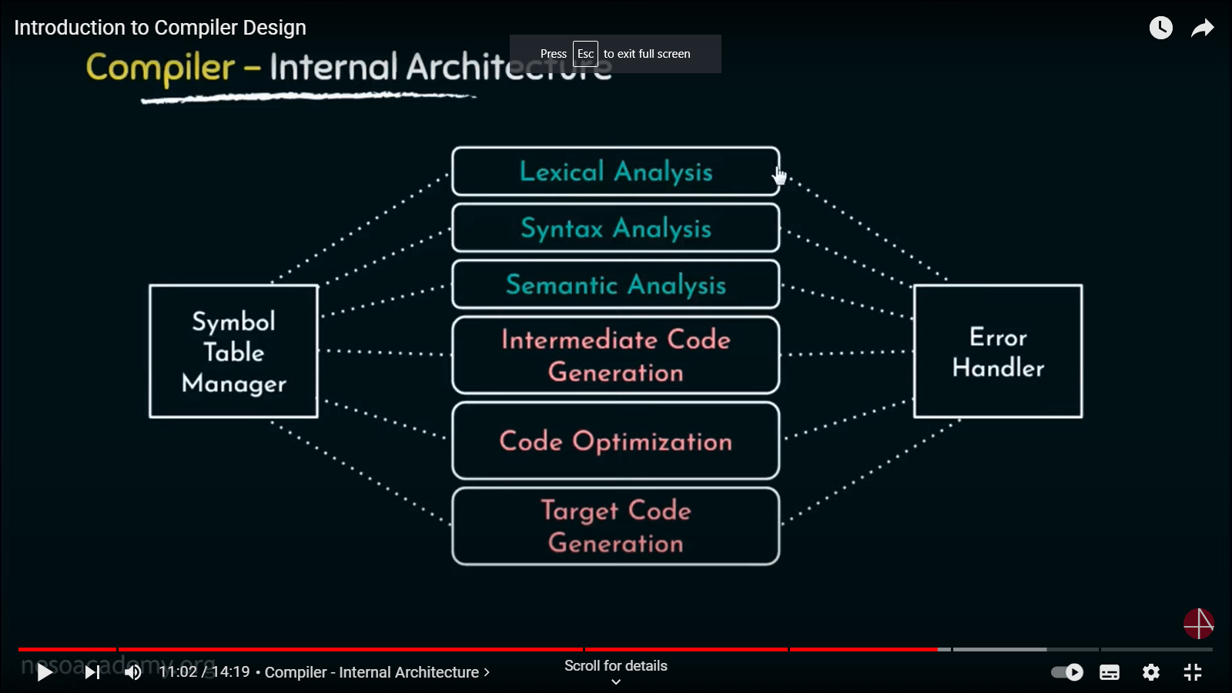

Slide 56
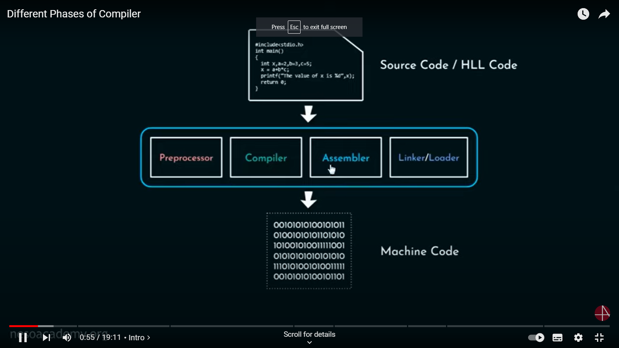

Slide 57
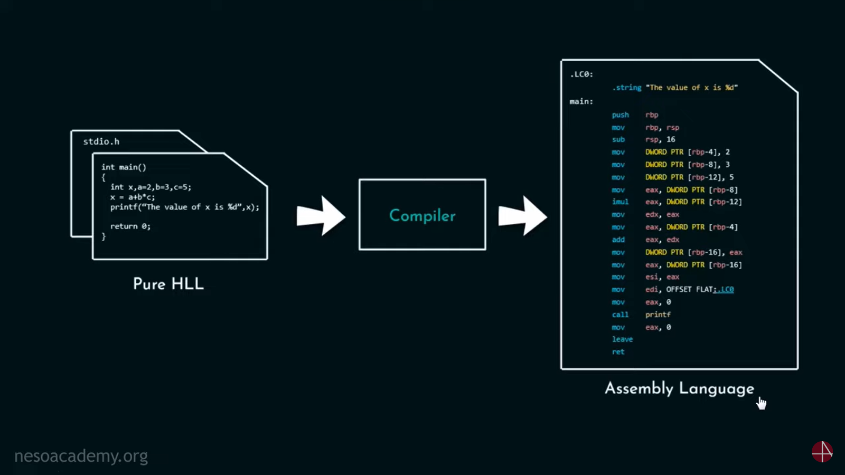

Slide 58
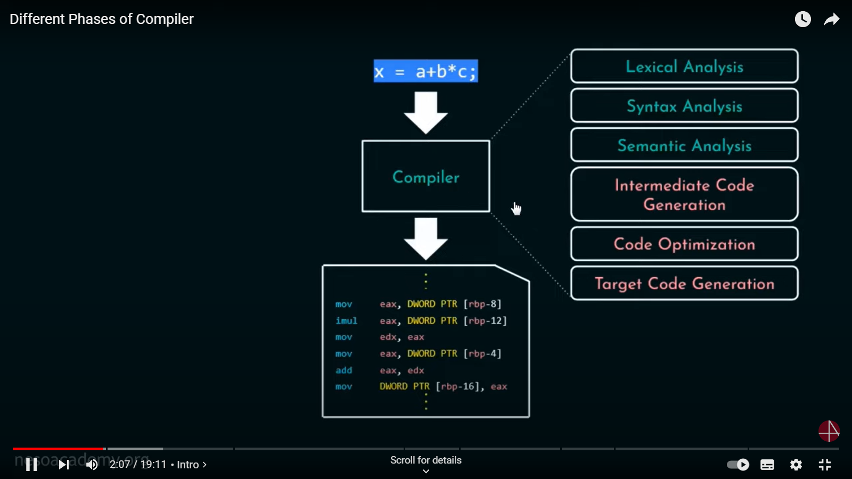

Slide 59
Phases of a Compiler - Front end cont’d
The front end includes all analysis phases and the intermediate code generator.
Lexical analysis is the first phase of compiler which is also termed as scanning.
During this phase, Source program is scanned to read the stream of characters and those characters are grouped to form a sequence called lexemes which produces token as output. Tokens are defined by regular expressions which are understood by the lexical analyzer.

Slide 60
Lexical Analysis
lexical analysis: The process of converting a sequence of characters (such as in a computer program) into a sequence of tokens (strings with an identified "meaning")
Lexical analysis takes the modified source code from language preprocessors that are written in the form of sentences.
The lexical analyzer breaks these syntaxes into a series of tokens, by removing any whitespace or comments in the source code.

Slide 61
Lexical Analysis
The lexical analyzer (either generated automatically by a tool like lex, or hand-crafted) reads in a stream of characters, identifies the lexemes in the stream, and categorizes them into tokens.
This is called "tokenizing". If the lexer finds an invalid token, it will report an error.

Slide 62
Front end: Terminologies
Token: Token is a sequence of characters that represent lexical unit, which matches with the pattern, such as keywords, operators, identifiers etc.
Lexeme: Lexeme is instance of a token i.e., group of characters forming a token.
Pattern: Pattern describes the rule that the lexemes of a token takes. It is the structure that must be matched by strings.

Slide 63
Token and Lexeme
Once a token is generated the corresponding entry is made in the symbol table.
At lexical analysis phase,
Input: stream of characters
Output: Token
Token Template:
<token-name, attribute-value>
For example, for c=a+b*5;
Hence,
<id, 1><=>< id, 2>< +><id, 3 >< * >< 5>

Slide 64
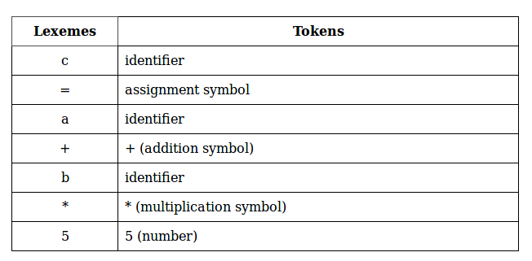
Token and Lexeme Cont’d

Slide 65
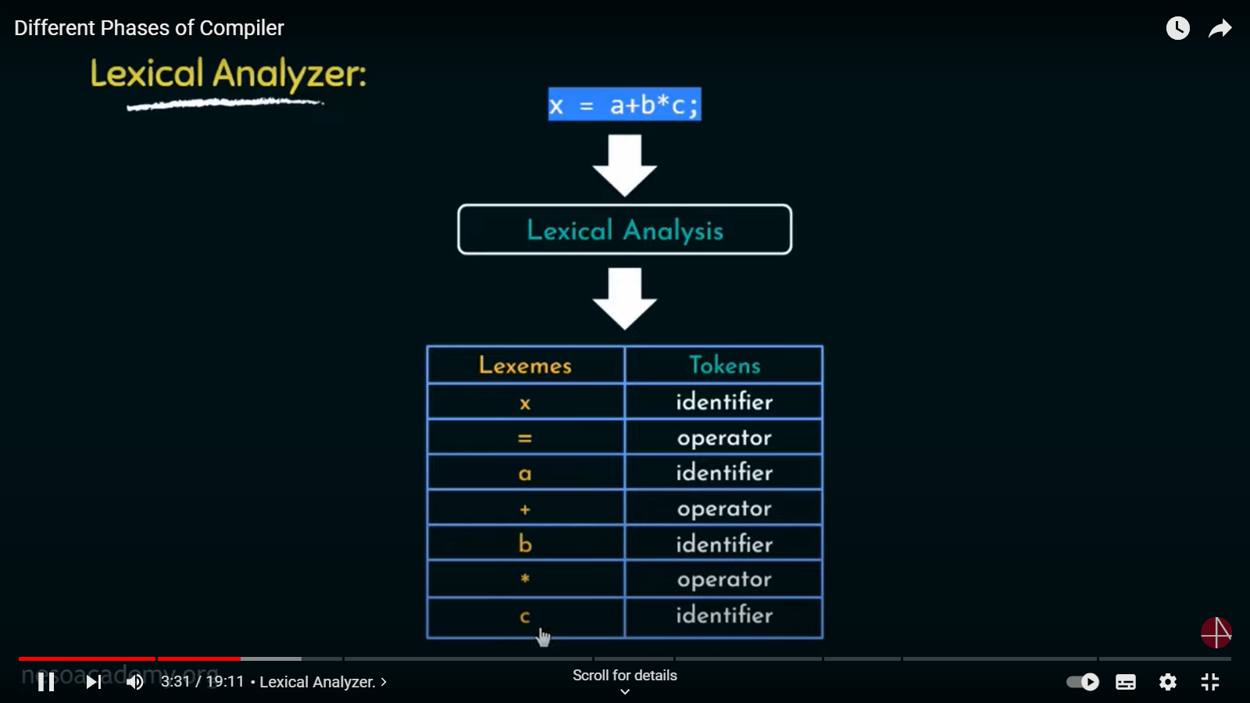

Slide 66
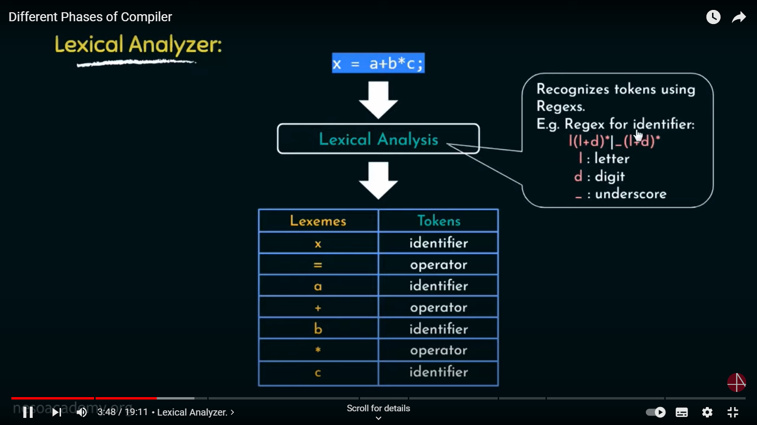

Slide 67
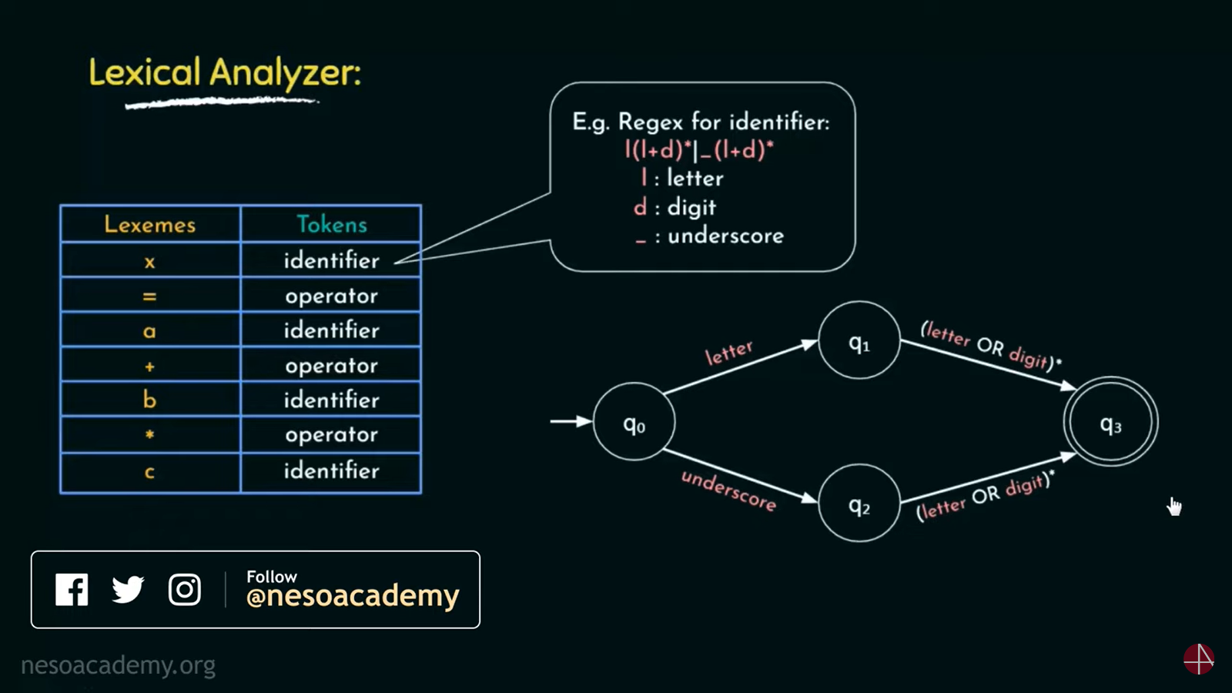

Slide 68
Syntax Analysis
Syntax Analyze is sometimes called as parser. It constructs the parse tree. It takes all the tokens one by one and uses Context Free Grammar to construct the parse tree.
Why Grammar ?
The rules of programming can be entirely represented in some few productions. Using these productions we can represent what the program actually is. The input has to be checked whether it is in the desired format or not.

Slide 69
Syntax Analysis cont’d
Syntax error can be detected at this level if the input is not in accordance with the grammar.

Slide 70
Syntactic Analysis
Parsing or syntactic analysis is the process of analyzing a string of symbols, either in natural language or in computer languages, conforming to the rules of a formal grammar
Parse: analyze (a string or text) into logical syntactic components, typically in order to test conformability to a logical grammar.

Slide 71
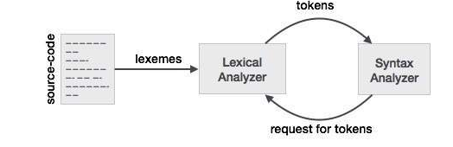
Syntactic Analysis cont’d
If the lexical analyzer finds a token invalid, it generates an error.
The lexical analyzer works closely with the syntax analyzer. It reads character streams from the source code, checks for legal tokens, and passes the data to the syntax analyzer when it demands.

Slide 72
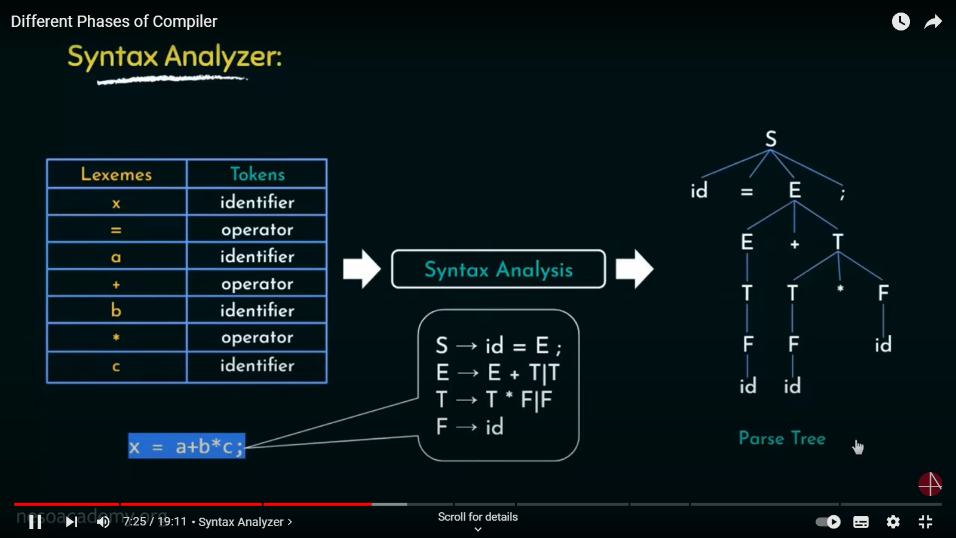

Slide 73
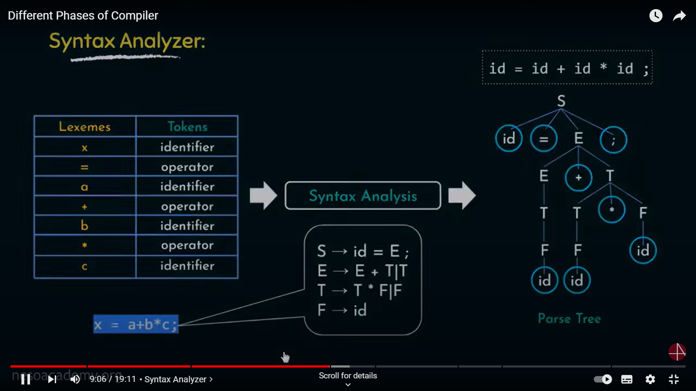

Slide 74
Semantic Analysis
Semantic analyzer takes the output of syntax analyzer and produces another tree.
Similarly, intermediate code generator takes a tree as an input produced by semantic analyzer and produces intermediate code.

Slide 75
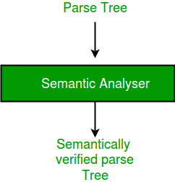
Semantic Analyzer

Slide 76
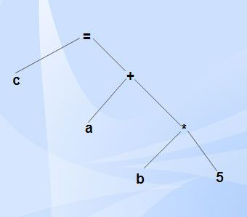
Semantic Analysis cont’d
Syntax tree is a compressed representation of the parse tree (a hierarchical structure that represents the derivation of the grammar to obtain input strings) in which the operators appear as interior nodes and the operands of the operator are the children of the node for that operator.
Example of syntax tree

Slide 77
Semantic Analyzer
Semantic analysis is the third phase of compiler.
It checks for the semantic consistency.
Type information is gathered and stored in symbol table or in syntax tree.
Performs type checking.
It verifies the parse tree, whether it’s meaningful or not. It furthermore produces a verified parse tree.

Slide 78
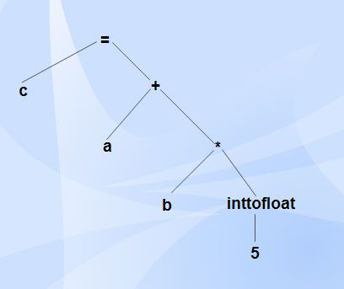
Semantic Analyzer

Slide 79
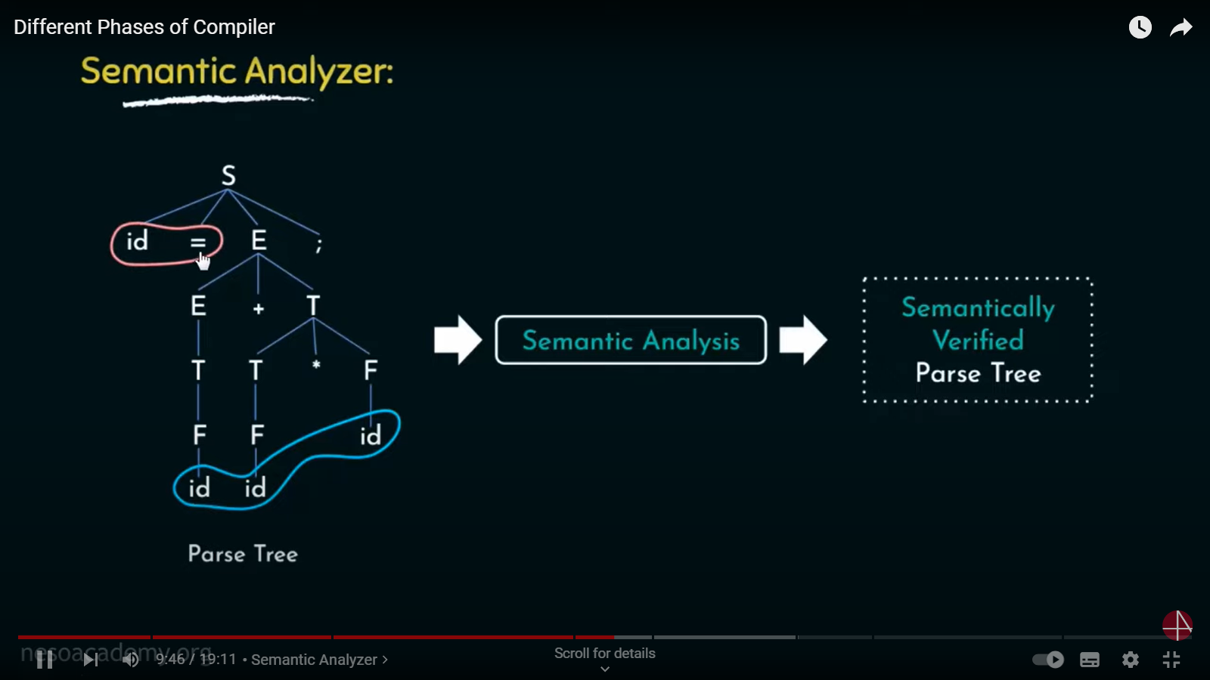

Slide 80
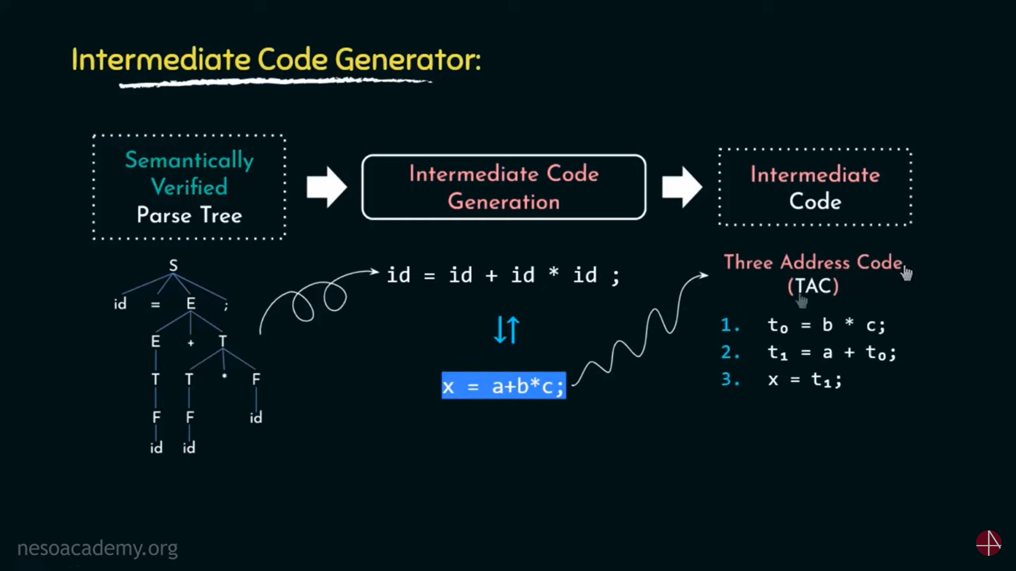

Slide 81
Intermediate Code Generation
After semantic analysis the compiler generates an intermediate code of the source code for the target machine.
It represents a program for some abstract machine.
It is in between the high-level language and the machine language.
This intermediate code should be generated in such a way that it makes it easier to be translated into the target machine code.

Slide 82
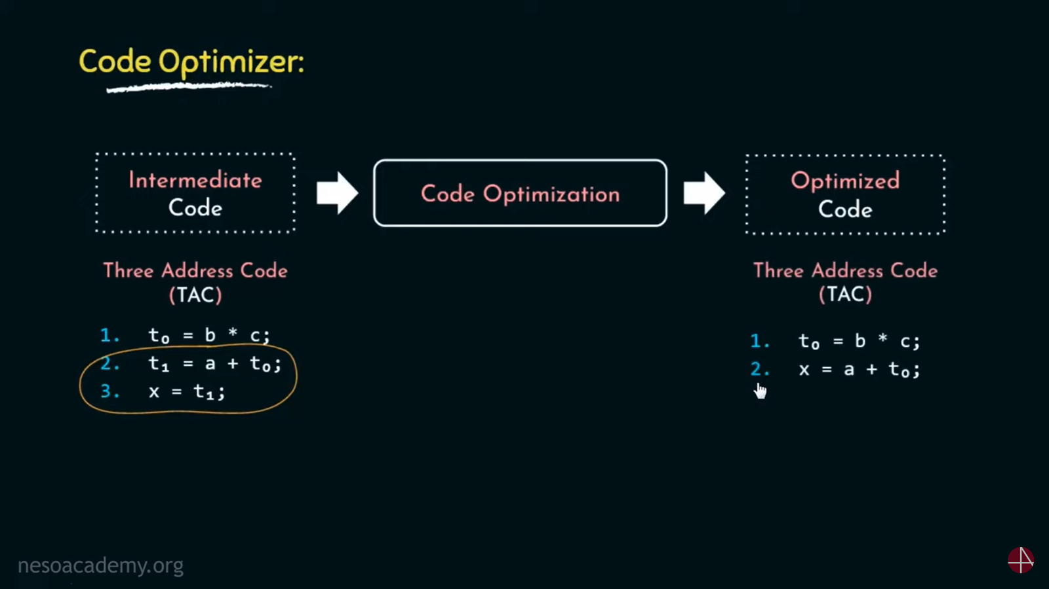

Slide 83
Code Optimization
Optimization can be assumed as something that removes unnecessary code lines, and arranges the sequence of statements in order to speed up the program execution without wasting resources (CPU, memory).

Slide 84
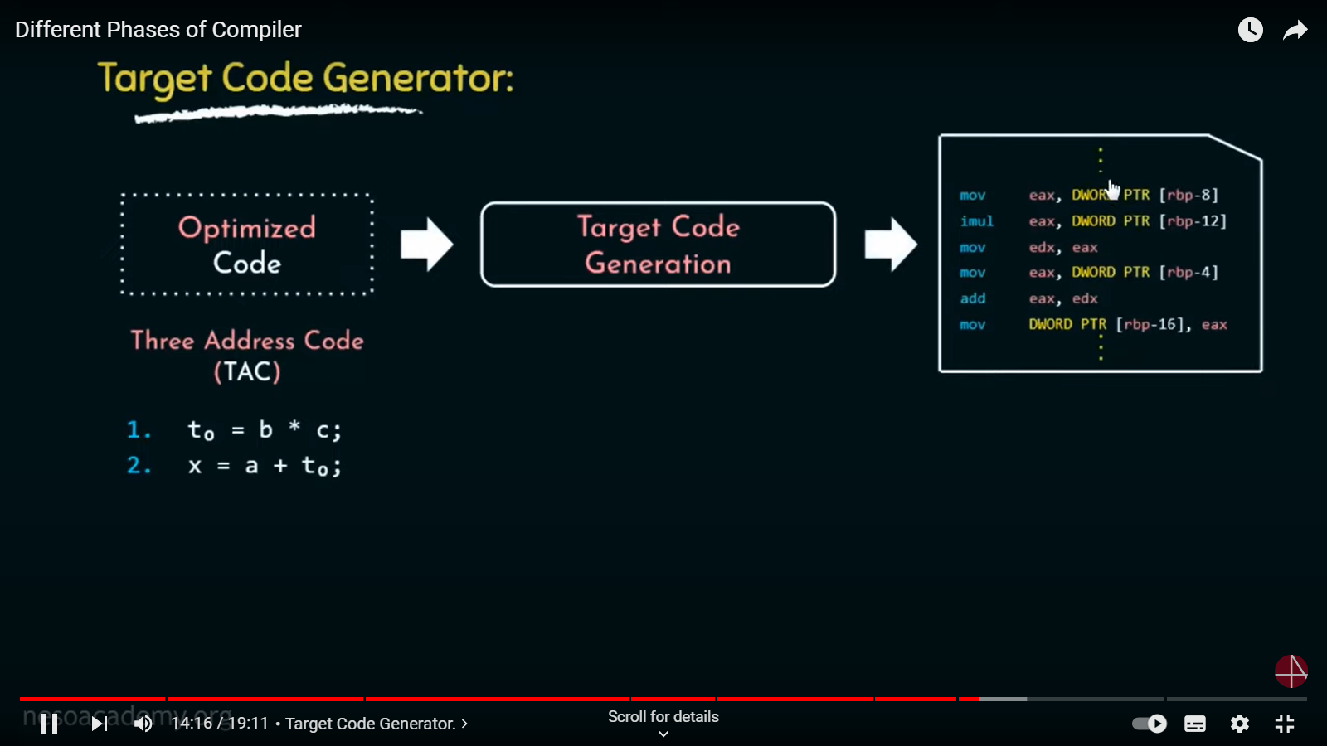

Slide 85
Code Generation
In this phase, the code generator takes the optimized representation of the intermediate code and maps it to the target machine language.
The code generator translates the intermediate code into a sequence of (generally) re-locatable machine code. Sequence of instructions of machine code performs the task as the intermediate code would do.

Slide 86
Symbol Table
It is a data-structure maintained throughout all the phases of a compiler.
All the identifier's names along with their types are stored here.
The symbol table makes it easier for the compiler to quickly search the identifier record and retrieve it. The symbol table is also used for scope management.

Slide 87
Compiler-Construction Tools
Software development tools are available to implement one or more compiler phases
Scanner generators
Parser generators
Syntax-directed translation engines
Automatic code generators
Data-flow engines

Slide 88
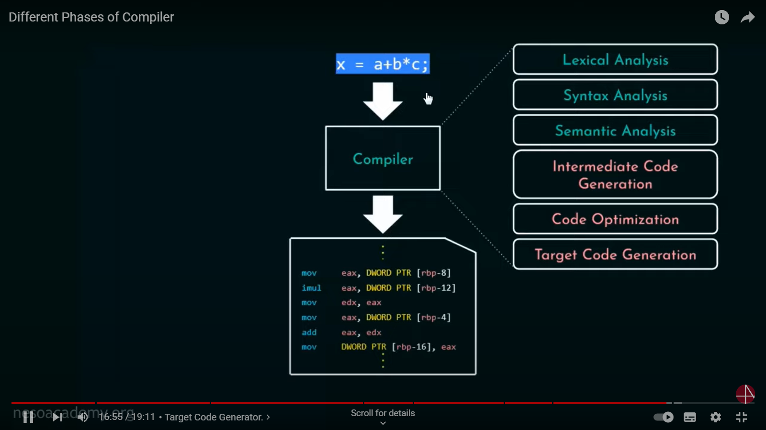

Slide 89
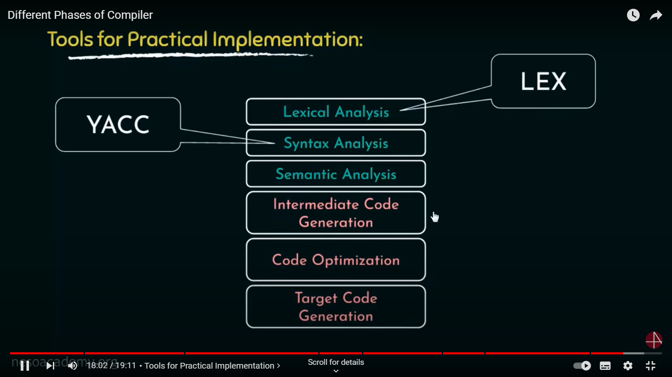

Slide 90
Structure of Compiler-Phases of Compiler
Symbol Table Management
Grouping of Phases into Passes
Compiler Vs Interpreter.
Role and need of Lexical Analyzer
Input Buffering
Regular expressions for identifiers
Language for specifying Lexical Analyzer, Lexical phase errors.

Slide 91
Symbol Table
Symbol table is an important data structure used in a compiler.
Symbol table is used to store the information about the occurrence of various entities such as objects, classes, variable name, interface, function name etc.
It is used by both the analysis and synthesis phases.

Slide 92
It is used to store the name of all entities in a structured form at one place.
It is used to verify if a variable has been declared.
It is used to determine the scope of a name.
It is used to implement type checking.
For example, suppose a variable store the information about the following variable
Declaration
static int salary
then, it stores an entry in the following format <salary, int, static>
<symbol name, type, attribute>

Slide 93
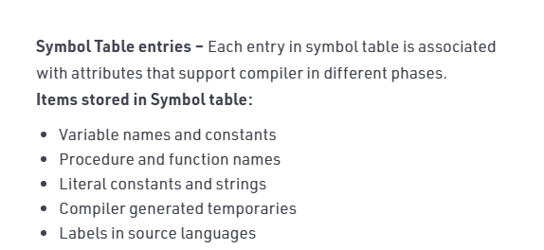
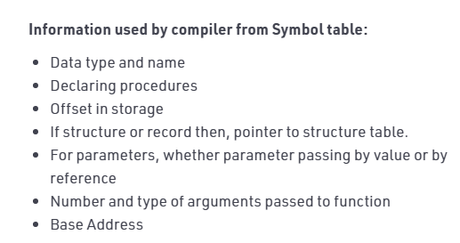

Slide 94
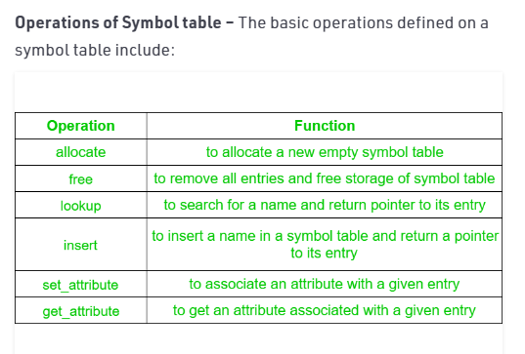

Slide 95
Implementation
A symbol table can be implemented in one of the following ways
Linear (sorted or unsorted) list
Binary Search Tree
Hash table
symbol tables are mostly implemented as hash tables.
In hashing scheme two tables are maintained – a hash table and symbol table
Insertion and lookup can be made very fast O(1).
Advantage is quick search is possible and disadvantage is complicated to implement.

Slide 96
Data structure for symbol table
A compiler contains two type of symbol table: global symbol table and scope symbol table.
Global symbol table can be accessed by all the procedures and scope symbol table.
The scope of a name and symbol table is arranged in the hierarchy structure as shown below:
int value=10;

Slide 97
void sum_num()
{
int num_1;
int num_2;
{
int num_3;
int num_4;
}
int num_5;
{
int_num 6;
int_num 7;
}
}
Void sum_id
{
int id_1;
int id_2;
{
int id_3;
int id_4;
}
int num_5;
}

Slide 98
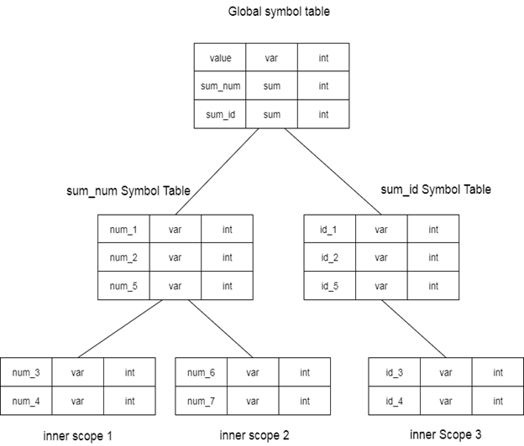
The above grammar can be represented in a hierarchical data structure of symbol tables:

Slide 99
The above grammar can be represented in a hierarchical data structure of symbol tables:
Representing Scope Information
In the source program, every name possesses a region of validity, called the scope of that name.
int x;
void f(int m)
{
float x, y;
{
int i, j;
int u, v;
}
}
int g (int n)
{
bool t;
}

Slide 100
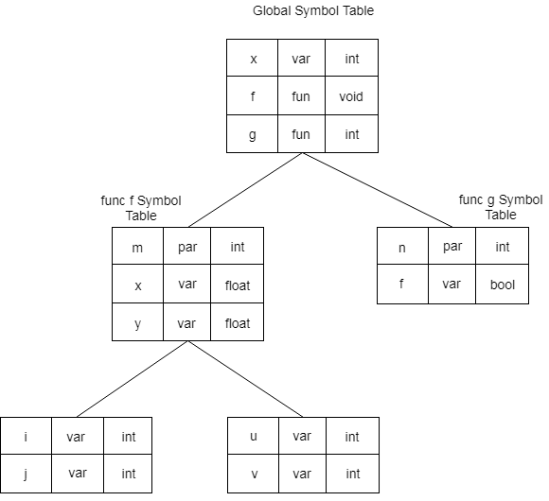

Slide 101
Structure of Compiler-Phases of Compiler
Symbol Table Management
Grouping of Phases into Passes
Compiler Vs Interpreter.
Role and need of Lexical Analyzer
Input Buffering
Regular expressions for identifiers
Language for specifying Lexical Analyzer, Lexical phase errors.

Slide 102
GROUPING OF THE PHASES
Compiler can be grouped into front and back ends:
Front end: analysis (machine independent)
These normally include lexical and syntactic analysis, the creation of the symbol
table,semantic analysis and the generation of intermediate code.
Back end: synthesis (machine dependent)
It includes code optimization phase and code generation .
Compiler passes
A collection of phases is done only once (single pass) or multiple times (multi pass)
·Single pass: usually requires everything to be defined before being used in
source program.
·Multi pass: compiler may have to keep entire program representation in
memory.

Slide 103
Structure of Compiler-Phases of Compiler
Symbol Table Management
Grouping of Phases into Passes
Compiler Vs Interpreter.
Role and need of Lexical Analyzer
Input Buffering
Regular expressions for identifiers
Language for specifying Lexical Analyzer, Lexical phase errors.

Slide 104
History of Compiler
The "compiler" word was first used in the early 1950s by Grace Murray Hopper.
The first compiler was build by John Backum and his group between 1954 and 1957 at IBM.
COBOL was the first programming language which was compiled on multiple platforms in 1960.
The study of the scanning and parsing issues were pursued in the 1960s and 1970s to provide a complete solution.

Slide 105
Features of Compilers
Correctness and Speed of compilation
Preserve the correct meaning of the code
The speed of the target code
Recognize legal and illegal program constructs
Good error reporting/handling and Code debugging help
Types of Compiler
Single Pass Compilers
Two Pass Compilers
Multipass Compilers

Slide 106
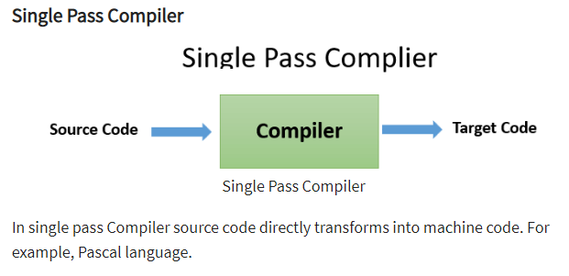
Single Pass Compiler
In single pass Compiler source code directly transforms into machine code.

Slide 107
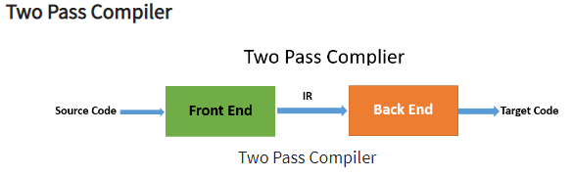
Two Pass Compiler
Front end: It maps legal code into Intermediate Representation (IR).
Back end: It maps IR onto the target machine

Slide 108
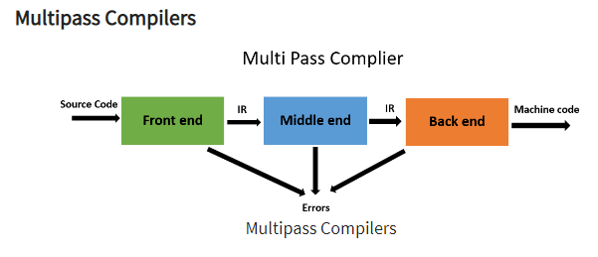
Multipass Compilers
It processes the source code or syntax tree of a program several times. It divided a large program into multiple small programs and process them. It develops multiple intermediate codes.

Slide 109
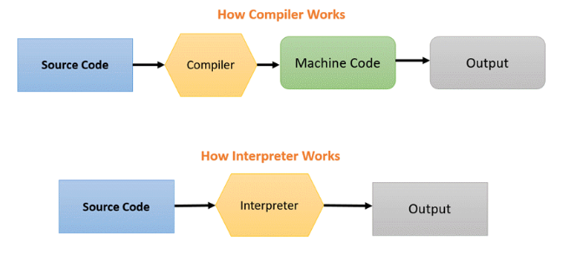

Slide 110
COMPILER | INTERPRETER
It considers the complete program as input for converting to machine code. | It considers 1 statement in your program at a time as input for converting to machine code.
Faster execution of control statements as compared to the interpreter. | Slower execution of control statements as compared to the compiler
Detected errors in the program get displayed after the entire program is read by compiler. | Detected errors in the program get displayed after each instruction read by the interpreter
Compiler is based on translation linking-loading model. | Interpreter is based on Interpretation Method.
Intermediate object code is generated | No intermediate object code is generated
Memory requirement is more | Memory requirement is less

Slide 111
Programming Steps | Create the program. Compile will parse all of the language statements for its correctness. If incorrect, throws an error. If no error, the compiler will convert source code to Machine code. It links different code files into runnable program (know as exe) Run the Program | Create the Program No linking of files or machine code generation Source statements executed line by line during Execution
Advantage | The program code is already translated into machine code. Thus, it code execution time is less. | Interpreters are easier to use, especially for beginners.
Disadvantage | You can't change the program without going back to the source code. | Interpreted programs can run on computers that have the corresponding interpreter.

Slide 112
Program generation | Generates output program (in the form of exe) which can be run independently from the original program. | Do not generate output program. So they evaluate the source program at every time during execution.
Execution | Program execution is separate from the compilation. It performed only after the entire output program is compiled. | Program Execution is a part of Interpretation process, so it is performed line by line.
Memory requirement | Target program execute independently and do not require the compiler in the memory. | The interpreter exists in the memory during interpretation.

Slide 113
Best suited for | Bounded to the specific target machine and cannot be ported. C and C++ are a most popular a programming language which uses compilation model. | For web environments, where load times are important. Due to all the exhaustive analysis is done, compiles take relatively larger time to compile even small code that may not be run multiple times. In such cases, interpreters are better.
Code Optimization | The compiler sees the entire code upfront. Hence, They perform lots of optimizations that make code run faster | Interpreters see code line by line, and thus optimizations are not as robust as compilers.
Dynamic Typing | Difficult to implement as compilers cannot predict what happens at turn time. | Interpreted languages support Dynamic Typing
Usage | It is best suited for the Production Environment | It is best suited for the program and Development environment.

Slide 114
Error execution | Compiler displays all errors and warning at the compilation time. Therefore, you can't run the program without fixing errors | The interpreter reads a single statement and shows the error if any. You must correct the error to interpret next line.
Input | It takes an entire program | It takes a single line of code.
Output | Compliers generates intermediate machine code. | Interpreter never generate any intermediate machine code.
Errors | Display all errors after, compilation, all at the same time. | Displays all errors of each line one by one.
Pertaining Programming languages | C,C++,C#, Java all use complier. | PHP, Perl, Ruby uses an interpreter.

Slide 115
Machine code | Store machine language as machine code on the disk | Not saving machine code at all.
Running time | Compiled code run faster | Interpreted code run slower
Model | It is based on language Translation linking-loading model. | It is based on Interpretation Method

Slide 116
Structure of Compiler-Phases of Compiler
Symbol Table Management
Grouping of Phases into Passes
Compiler Vs Interpreter.
Role and need of Lexical Analyzer
Input Buffering
Regular expressions for identifiers
Language for specifying Lexical Analyzer, Lexical phase errors.

Slide 117
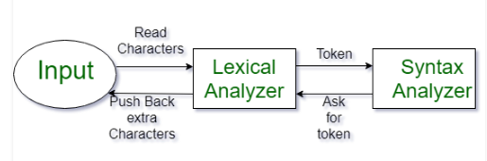
Lexical Analysis
Lexical Analysis is the first phase of the compiler also known as a scanner. It converts the High level input program into a sequence of Tokens.
Lexical Analysis can be implemented with the Deterministic finite Automata.
The output is a sequence of tokens that is sent to the parser for syntax analysis

Slide 118
lexical analyzers are divided into a cascade of two processes:
Scanning
consists of the simple processes that do not require tokenization of the
input, such as deletion of comments and compaction of consecutive
whitespace characters into one.
Lexical analysis
proper is the more complex portion, where the scanner produces the
sequence of tokens as output.

Slide 119
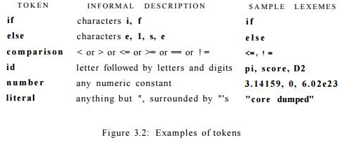
In many programming languages, the following classes cover most or all of the tokens

Slide 120
What's a lexeme?
Lexemes are said to be a sequence of characters (alphanumeric) in a token. There
are some predefined rules for every lexeme to be identified as a valid token.
What's a token?
These rules are defined by grammar rules, by means of a pattern. A pattern explains
what can be a token, and these patterns are defined by means of regular
expressions.
What is Pattern?
In programming language, keywords, constants, identifiers, strings, numbers,
operators and punctuations symbols can be considered as tokens.

Slide 121
Roles of the Lexical analyzer
Helps to identify token into the symbol table.
Removes white spaces and comments from the source program.
Correlates error messages with the source program.
Helps you to expands the macros if it is found in the source program.
Read input characters from the source program

Slide 122
Example of Lexical Analysis, Tokens, Non-Tokens
Consider the following code that is fed to Lexical Analyzer
#include <stdio.h>
int maximum(int x, int y)
{ // This will compare 2 numbers
if (x > y)
return x;
Else
{
return y;
}
}

Slide 123
Lexeme | Token
int | Keyword
maximum | Identifier
( | Operator
int | Keyword
x | Identifier
, | Operator
int | Keyword
Y | Identifier
) | Operator
{ | Operator
If | Keyword

Slide 124
Examples of Nontokens
Type | Examples
Comment | // This will compare 2 numbers
Pre-processor directive | #include <stdio.h>
Pre-processor directive | #define NUMS 8,9
Macro | NUMS
Whitespace | /n /b /t

Slide 125
Attributes for Tokens
The token names and associated attribute values for the For-tran statement
E = M * C ** 2
are written below as a sequence of pairs.
<id, pointer to symbol-table entry for E>
<assign _ op>
<id, pointer to symbol-table entry for M>
<mult _ op>
<id, pointer to symbol-table entry for C>
<exp _ op>
<number, integer value 2>

Slide 126
Lexical Errors
A character sequence which is not possible to scan into any valid token is a lexical error.
Lexical errors are not very common, but it should be managed by a scanner.
Misspelling of identifiers, operators, keyword are considered as lexical errors.
Error Recovery in Lexical Analyzer
Removes one character from the remaining input.
In the panic mode, the successive characters are always ignored until we reach a well-formed token.
By inserting the missing character into the remaining input.
Replace a character with another character.
Transpose two serial characters.

Slide 127
Advantages of Lexical analysis
Used by programs like compilers which can use the parsed data to create a compiled binary executable code.
It is used by web browsers to format and display a web page with the help of parsed data from JavaScript, HTML, CSS
A separate lexical analyzer helps you to construct a specialized and potentially more efficient processor for the task
Disadvantage of Lexical analysis
You need to spend significant time reading the source program and partitioning it in the form of tokens
Some regular expressions are quite difficult to understand.
More effort is needed to develop and debug the lexer and its token descriptions.
Additional runtime overhead is required to generate the lexer tables and construct the tokens

Slide 128
Why separate Lexical and Parser?
The simplicity of design: It eases the process of lexical analysis and the syntax analysis by eliminating unwanted tokens.
To improve compiler efficiency: Helps you to improve compiler efficiency.
Specialization: specialized techniques can be applied to improves the lexical analysis process.
Portability: only the scanner requires to communicate with the outside world.
Higher portability: input-device-specific peculiarities restricted to the lexer.

Slide 129
Lexical Analyser | Parser
Scan Input program | Perform syntax analysis
Identify Tokens | Create an abstract representation of the code
Insert tokens into Symbol Table | Update symbol table entries
It generates lexical errors | It generates a parse tree of the source code

Slide 130
Structure of Compiler-Phases of Compiler
Symbol Table Management
Grouping of Phases into Passes
Compiler Vs Interpreter.
Role and need of Lexical Analyzer
Input Buffering
Regular expressions for identifiers
Language for specifying Lexical Analyzer, Lexical phase errors.

Slide 131
Input Buffering
In C, single-character operators like -, =, or < could also be the beginning of a
two-character operator like ->, ==, or <=.
Thus, we shall introduce a two-buffer scheme that handles large look aheads
safely.
Buffer Pairs
Time taken to process characters and the large number of characters that must be
processed during the compilation of a large source program, specialized buffering
techniques have been developed to reduce the amount of overhead required to
process a single input character. An important scheme involves two buffers that
are alternately reloaded.

Slide 132
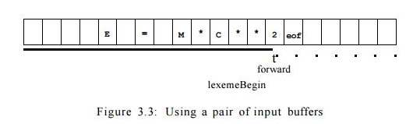
Each buffer is of the same size N, and N is usually the size of a disk block, e.g., 4096 bytes. special character, represented by eof, marks the end of the source file and is different from any possible character of the source program.
Pointer lexemeBegin, marks the beginning of the current lexeme,
Pointer forward scans ahead until a pattern match is found

Slide 133
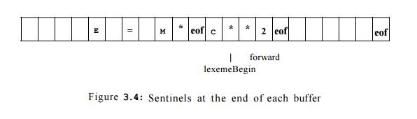
Sentinels
For each character read, we make two tests ,one for the end of the buffer, and one to determine what character is read.
The sentinel is a special character that cannot be part of the source program, and a natural choice is the character eof.

Slide 134
switch ( *forward++ ) {
case eof:
if (forward is at end of first buffer ) {
reload second buffer;
forward = beginning of second buffer;
}
else if (forward is at end of second buffer ) {
reload first buffer;
forward = beginning of first buffer;
}
else /* eof within a buffer marks the end of input */
terminate lexical analysis;
break;
Cases for the other characters
}
Figure 3.5: Look ahead code with sentinels

Slide 135
Can We Run Out of Buffer Space?
In most modern languages, lexemes are short, and one or two characters of lookahead is sufficient.
To avoid problems with long character strings, we can treat them as a concatenation of components.
Java ,it is conventional to represent long strings by writing a piece on each line and concatenating pieces with a + operator at the end of each piece.
Some languages like P L / I do not treat key- words as reserved; that is, you can use identifiers with the same name as a keyword like DECLARE.
Modern languages tend to reserve their keywords. However, if not, one can treat a keyword like DECLARE as an ambiguous identifier, and let the parser resolve the issue, perhaps in conjunction with symbol-table lookup.

Slide 136
Structure of Compiler-Phases of Compiler
Symbol Table Management
Grouping of Phases into Passes
Compiler Vs Interpreter.
Role and need of Lexical Analyzer
Input Buffering
Regular expressions for identifiers
Language for specifying Lexical Analyzer, Lexical phase errors.

Slide 137
Regular Expressions
Regular expressions are an important notation for specifying lexeme patterns. While they cannot express all possible patterns, they are very effective in
specifying those types of patterns that we actually need for tokens.
we were able to describe identifiers by giving names to sets of letters and digits and using the language operators union, concatenation, and closure.
If letter _ is established to stand for any letter or the underscore, and digit is established to stand for any digit, then we could describe the language of C identifiers by
letter_( letter_\digit )*
The vertical bar means union, the parentheses are used to group sub expressions, the star means zero or more occurrences .

Slide 138
The regular expressions are built recursively out of smaller regular expressions.
Each regular expression r denotes a language L(r), which is also defined recursively from the languages denoted by r's subexpressions.
The rules that define the regular expressions over some alphabet £ and the languages that those expressions denote.
There are two rules that form the basis:
e is a regular expression, and L(e) is {e}, that is, the language whose sole member is the empty string.
2. If a is a symbol in E, then a is a regular expression, and L(a) = {a}, that is, the language with one string, of length one, with a in its one position.

Slide 139
INDUCTION: There are four parts to the induction whereby larger
regular expressions are built from smaller ones. Suppose r and s are regular
expressions denoting languages L(r) and L(s), respectively.
(r)|(s) is a regular expression denoting the language L(r) U L(s).
(r)(s) is a regular expression denoting the language L(r)L(s).
(r)* is a regular expression denoting (L(r))*.
(r) is a regular expression denoting L(r). This last rule says that we can add additional pairs of parentheses around expressions without changing the language they denote.

Slide 140
Regular expressions often contain unnecessary pairs of parentheses. We may
drop certain pairs of parentheses if we adopt the conventions that:
The unary operator * has highest precedence and is left associative.
Concatenation has second highest precedence and is left associative.
| has lowest precedence and is left associative.
For example, we may replace the regular expression (a)|((b)*(c)) by a|b*c.
Both expressions denote the set of strings that are either a single a or are zero or
more b's followed by one c.

Slide 141
Let £ = {a, b}.
1. The regular expression a|b denotes the language {a, b}.
2. (a|b)(a|b) denotes {aa, ab, ba, bb}, the language of all strings of length two over the alphabet E. Another regular expression for the same language is aa|ab|ba|bb .
3. a* denotes the language consisting of all strings of zero or more a's, that is, { e , a , a a , a a a , . . . } .
4. (a|b)* denotes the set of all strings consisting of zero or more instances of a or b, that is, all strings of a's and b's: {e,a, b,aa, ab, ba, bb,aaa,...}. Another regular expression for the same language is (a*b*)*.
5. a|a*b denotes the language {a, b, ab, aab, aaab,...}, the string a and all strings consisting of zero or more a's and ending in b.

Slide 142
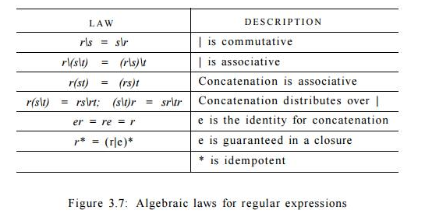
Language that can be defined by a regular expression is called a Regular set. If two regular expressions r and s denote the same regular set, we say they are equivalent and write r = s. There are a number of algebraic laws for regular expressions; each law asserts that expressions of two different forms are equivalent.

Slide 143
Let £ = {a, b}.
1. The regular expression a|b denotes the language {a, b}.
2. (a|b)(a|b) denotes {aa, ab, ba, bb}, the language of all strings of length two over the alphabet E. Another regular expression for the same language is aa|ab|ba|bb .
3. a* denotes the language consisting of all strings of zero or more a's, that is, { e , a , a a , a a a , . . . } .
4. (a|b)* denotes the set of all strings consisting of zero or more instances of a or b, that is, all strings of a's and b's: {e,a, b,aa, ab, ba, bb,aaa,...}. Another regular expression for the same language is (a*b*)*.
5. a|a*b denotes the language {a, b, ab, aab, aaab,...}, the string a and all strings consisting of zero or more a's and ending in b.

Slide 144
C identifiers are strings of letters, digits, and underscores. Here is a regular
definition for the language of C identifiers
Letter_ -> A | B | - - - | Z | a | b | - - - | z | _
Digit -> 0 / 1 • • • / 9
Id -> letter_ ( letter_ / digit )*
Example 3 . 6 : Unsigned numbers (integer or floating point) are strings such
as 5280, 0.01234, 6.336E4, or 1.89E-4. The regular definition
digit -> 0 | 1 … 9
digits -> digit digit*
optionalFraction -> . digits | e
optionalExponent -> ( E ( + | - | e ) digits ) | e
number -> digits optionalFraction optionalExponent

Slide 145
Structure of Compiler-Phases of Compiler
Symbol Table Management
Grouping of Phases into Passes
Compiler Vs Interpreter.
Role and need of Lexical Analyzer
Input Buffering
Regular expressions for identifiers
Language for specifying Lexical Analyzer, Lexical phase errors.

Slide 146
A LANGUAGE FOR SPECIFYING LEXICAL ANALYZER
Use of Lex
Structure of Lex Programs
Conflict Resolution in Lex
The Lookahead Operator
Lex is a program that generates lexical analyzer. It is used with YACC parser
generator.
LEX
YAAC
YACC- YET ANOTHER COMPILER-COMPILER
Yacc provides a general tool for describing the input to a computer program.

Slide 147
Use of Lex
The input notation for the Lex tool is referred to as the Lex language and the tool
itself is the Lex compiler.
The function of Lex is as follows:
Firstly lexical analyzer creates a program lex.1 in the Lex language. Then Lex compiler runs the lex.1 program and produces a C program lex.yy.c.
Finally C compiler runs the lex.yy.c program and produces an object program a.out.
a.out is lexical analyzer that transforms an input stream into a sequence of tokens.

Slide 148
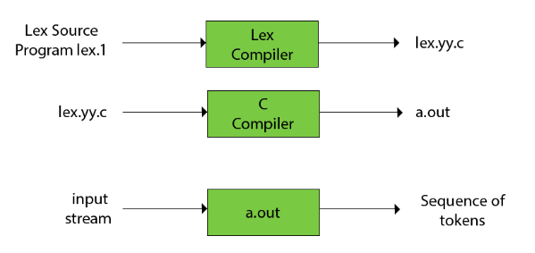

Lex file format
A Lex program is separated into three sections by %% delimiters. The formal of Lex source is as follows

Slide 149
Structure of Lex Programs
Definitions or declarations include declarations of constant, variable and regular definitions.
Translation Rules define the statement of form Pattern { Action }
p1 {action1} p2 {action2}....pn {action}.
Where p1 describes the regular expression and action1 describes the actions what action the lexical analyzer should take when pattern p1 matches a lexeme.
3. User subroutines are auxiliary procedures needed by the actions. The subroutine can be loaded with the lexical analyzer and compiled separately.

Slide 150
Conflict Resolution in Lex
We have alluded to the two rules that Lex uses to decide on the proper lexeme to select, when several prefixes of the input match one or more patterns
Always prefer a longer prefix to a shorter prefix.
If the longest possible prefix matches two or more patterns, prefer the pattern listed first in the Lex program.
It tells us to treat <= as a single lexeme, rather than selecting < as one lexeme and = as the next lexeme.
For instance, if t h e n is determined to be the longest prefix of the input that matches any pattern, and the pattern then precedes { i d } , then the token THEN is returned, rather than ID.

Slide 151
The Lookahead Operator
Lex automatically reads one character ahead of the last character that forms the selected lexeme, and then retracts the input so only the lexeme itself is consumed from the input.
In Fortran and some other languages, keywords are not re-served. That situation creates problems, such as a statement
IF(I,J) = 3
where IF is the name of an array, not a keyword. This statement contrasts with statements of the form
IF( condition ) THEN ...

Slide 152
Declarations
%{
/* definitions of manifest constants LT, LE, EQ, NE, GT, GE,
IF, THEN, ELSE, ID, NUMBER, RELOP */
%}
/* regular definitions */
delim [ \t\n]
ws {delim}+
letter [A-Za-z]
digit [0-9]
id {letter}({letter}|{digit})*
number {digit}+(\.{digit}+)?(E[+-]?{digit}+)?

Slide 153
number {digit}+(\.{digit}+)?(E[+-]?{digit}+)?{digit}+: This matches one or more
digit characters (0-9).
(\.{digit}+)?: Here:
\. matches a literal period (decimal point).
{digit}+ matches one or more digit characters.
The entire group ( ... )? is optional, meaning it may or may not appear.
So this part optionally matches a decimal point followed by one or more digits.
(E[+-]?{digit}+)?: Here:
E matches the character ‘E’.
[+-]? matches an optional plus or minus sign.
{digit}+ matches one or more digit characters.
The entire group ( ... )? is optional, allowing for scientific notation (e.g., 1.23E-10).
In summary, this regular expression pattern matches various forms of numbers, including integers, decimals, and scientific notation. For example:
42
3.14
1.23E-10

Slide 154
Translation Rules
%%
{ws} {/* no action and no return */}
if {return(IF);}
Then {return(THEN);}
Else {return(ELSE);}
{id} {yylval = (int) installID(); return(ID);}
{number} {yylval = (int) installNumO ; return(NUMBER);}
“ <“ {yylval = LT; return(RELOP) ;}
"<=" {yylval = LE; return(RELOP) ;}
“=" {yylval = EQ; return(RELOP) ;}
"<>" {yylval = NE; return(RELOP) ;}
“>” {yylval = GT; return(RELOP) ;}
”>=“ {yylval = GE; return(RELOP) }
%%

Slide 155
Auxiliary Functions
int installD ()
{
/* function to install the lexeme, whose first character is pointed to by yytext, and whose length is yyleng, into the symbol table and return a pointer thereto */
}
int installNumO
{
/* similar to installlD, but puts numerical constants into a separate table */
}

Slide 156
What is Lex?
Lex is a program that generates lexical analyzers. It reads an input stream (usually a program’s source code) and produces a lexer (a component that breaks down the input into tokens).
Lex is commonly used alongside YACC (Yet Another Compiler Compiler) to build complete compilers.
How Does Lex Work?
Lex takes a set of regular expressions and corresponding actions as input.
It scans the input stream, recognizing patterns defined by the regular expressions.
When a pattern matches, Lex executes the associated action.

Slide 157
/* Lex program to count the number of words */
%{
#include <stdio.h>
#include <string.h>
int i = 0;
%}
/* Rules Section */
%%
[a-zA-Z0-9]+ { i++; } /* Rule for counting words */
"\n" { printf("%d\n", i); i = 0; }
%%
int yywrap(void) {}
int main() {
yylex();
return 0;
}

Slide 158
%{ ... %}: This section allows us to include C code.
%%: Separates the rules section.
[a-zA-Z0-9]+ { i++; }: Matches sequences of alphanumeric characters (words) and increments the counter.
"\n" { printf("%d\n", i); i = 0; }: Detects newline characters and prints the word count.
int yywrap(void) { } : Required for Lex programs.
main(): Calls yylex() to start lexical analysis.
Execution
Compile the Lex program using lex abc.l (where abc is the file name).
Then compile the generated lex.yy.c using cc lex.yy.c -o a.out.
Execute the program with ./a.out.

Slide 159
Execution
Compile the Lex program using lex abc.l (where abc is the file name).
Then compile the generated lex.yy.c using cc lex.yy.c -o a.out.
cc: Invokes the C compiler.
lex.yy.c: Specifies the input source file (the generated Lex output).
-o a.out: Specifies the output file name (a.out in this case).
Execute the program with ./a.out.

Slide 160
Lex (Lexical Analyzer):
Definition: Lex is a computer program that generates lexical analyzers.
Functionality: It reads an input stream (usually a program’s source code) and converts it into meaningful tokens (lexemes).
Role: Lex performs lexical analysis, breaking down the input into basic units (e.g., keywords, identifiers, strings).
Components:
Definition Section: Defines macros and includes header files in C.
Rules Section: Contains regular expression patterns with associated C statements.
C Code Section: Consists of additional C statements and functions.
Usage: Lex is often used in conjunction with Yacc (parser generator) to build complete compilers.
Open-Source Version: The popular open-source version of Lex is called Flex (Fast Lexical Analyzer).

Slide 161
Yacc (Yet Another Compiler-Compiler):
Definition: Yacc is a parser generator used in UNIX systems.
Functionality: It takes a grammar (attached to its rules) and generates a parse tree from the tokens produced by Lex.
Role: Yacc performs syntax analysis, creating a structured representation of the input.
Output: Yacc produces a shift-reduce parser in C.
Typical Actions: Executing C code associated with each rule (e.g., generating the parse tree).
GNU Bison: GNU-based Linux distributions often use Bison as a forward-compatible Yacc replacement.
In summary, Lex handles lexical analysis (tokenization), while Yacc focuses on parsing and constructing the parse tree. Together, they form a powerful duo for building compilers and interpreters.

Slide 162
Lex (calc.lex): The Lex program defines the lexical analysis rules for recognizing tokens (such as numbers, operators, and variables).
%{
#include <stdio.h>
int regs[26]; // Array to store variable values
%}
%%
[a-zA-Z] { return yytext[0]; } // Recognize single-letter variables
[0-9]+ { return atoi(yytext); } // Recognize integers
[+\-*/=()] { return yytext[0]; } // Recognize operators and parentheses
\n { return '\n'; } // Recognize newline
%%

Slide 163
Yacc (calc.yacc): The Yacc program defines the grammar rules and actions for parsing the input.
%{
#include <stdio.h>
int yylex();
void yyerror(const char* msg);
%}
%token LETTER DIGIT
%%
list: /*empty*/
| list stat '\n'
;
stat: expr
| LETTER '=' expr { regs[$1] = $3; }
;
expr: '(' expr ')' { $$ = $2; }
| expr '*' expr { $$ = $1 * $3; }
| expr '/' expr { $$ = $1 / $3; }
| expr '+' expr { $$ = $1 + $3; }
| expr '-' expr { $$ = $1 - $3; }
| LETTER { $$ = regs[$1]; }
| DIGIT
;
%%

Slide 164
int main() {
return yyparse();
}
void yyerror(const char* msg) {
fprintf(stderr, "%s\n", msg);
}
Compilation and Execution:
Compile the Lex program: lex calc.lex
Compile the Yacc program: yacc -d calc.yacc
Compile and link the generated C files: cc y.tab.c lex.yy.c -o calculator
Run the program: ./calculator
Input expressions (e.g., 3+4, x=10, x*2, etc.) and see the results.

Slide 165
%{ ... %}: This section is called the prologue and typically contains any necessary C code that should be included at the beginning of the generated parser file.
%token LETTER DIGIT: Here, you’re defining two token types: LETTER and DIGIT. These tokens will be used in your grammar rules.
%%: This delimiter separates the grammar rules from the prologue.
list: /*empty*/ | list stat '\n';: This rule defines a list of statements separated by newline characters. The /*empty*/ indicates an empty list.
stat: expr | LETTER '=' expr { regs[$1] = $3; }: This rule defines a statement. It can either be an expression or an assignment (e.g., x = 10). If it’s an assignment, it updates a register (regs) with the result of the expression.
expr: ...: This rule defines arithmetic expressions. It handles parentheses, multiplication, division, addition, subtraction, and references to registers (letters) or literal digits.
int main() { ... }: The main function is the entry point of your program. It likely calls yyparse() to start parsing input.
void yyerror(const char* msg) { ... }: This function is called when an error occurs during parsing. It prints an error message.

Slide 166
Finite Automata
Finite Automata is one of the mathematical models that consist of a number of
states and edges. It is a transition diagram that recognizes a regular expression or
grammar.There are tow types of Finite Automata .
Non-deterministic Finite Automata (NFA)
Deterministic Finite Automata (DFA)
Formal Definition of DFA is a collection of 5-tuples.
Q: finite set of states
∑: finite set of the input symbol
q0: initial state
F: final state
δ: Transition function

Slide 167
Formal definition of NFA
NFA also has five states same as DFA, but with different transition function,
δ: Q x ∑ →2^{Q}
Where as DFA has
δ: Q x ∑ → Q
The state is represented by vertices.
The arc labeled with an input character show the transitions.
The initial state is marked with an arrow.
The final state is denoted by a double circle.

Slide 168


DFA with ∑ = {0, 1} accepts all ending with 0.
NFA with ∑ = {0, 1} accepts all strings with 01.

Slide 169
Specification of Tokens
In compiler design, the specification of tokens defines the rules or criteria for recognizing different types of tokens within a given source code.
Tokens are significant instances of a sequence of characters that represent a unit in the grammar of a programming language.
The three main aspects of token specification are:
Strings: These are finite sets of symbols or characters. Symbols can be digits, alphabets, or other special characters. An empty string (denoted by ε) is also part of the specification.
Language: A language consists of a countable set of strings over a fixed alphabet. These strings form the valid constructs in the programming language.
Regular Expressions: Regular expressions are used to specify different patterns that form valid tokens. Although regular expressions may not cover all possible token patterns, they reveal various types of patterns that constitute tokens.

Slide 170
Recognition of Tokens
Recognition of tokens is a crucial step in the compilation process.
It involves breaking down the source code into understandable parts, such as words and symbols (tokens).
The lexical analyzer scans the entire source code and identifies each token one by one.
Tokens obtained during lexical analysis are recognized by finite automata (usually implemented as scanners).
This recognition helps the compiler understand the code’s structure and meaning, enabling further processing during parsing and semantic analysis.
The specification of tokens defines the rules for valid tokens, and the recognition of tokens ensures that these tokens are correctly identified during lexical analysis. Together, they play a crucial role in building a robust compiler

